Slide 1
Rainwater Harvesting
Janie Harris
Extension Specialist
Housing and Home Environment
Texas AgriLife Extension Service

Slide 2
Efficient Water Use is Critical
Limited water supply
Growing population
Rainwater catchment is a source of water
Water will not always be inexpensive

Slide 3
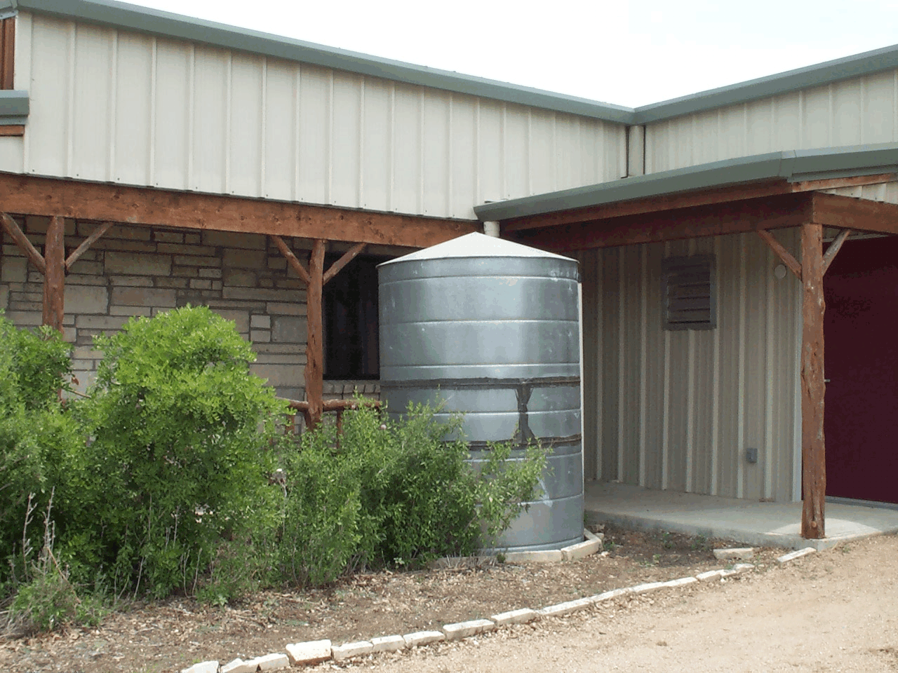
Why Collect Rainwater?
Increased Demand for a Decreasing Supply
Rising Environmental & Economic Costs
Rainwater’s Purity
Conservation – Saving Your Water!
Reduce Runoff – Crucial in Cities
Droughts have Increased Need & Awareness
Water for Areas w/o Groundwater or Service

Slide 4
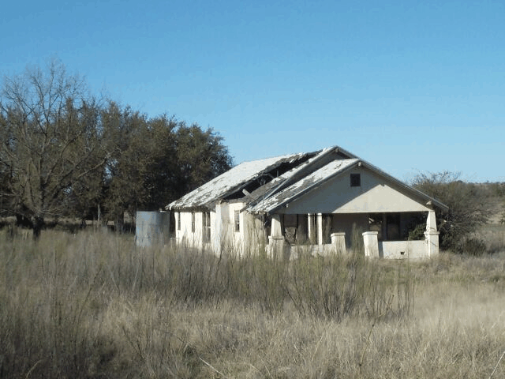



Cisterns - The only source of water for many before electricity and well drillers
Notes:
Cisterns have been around for a long time. A cistern is a primitive rainwater harvesting system. Today’s systems can be designed to capture and store water on land or in a storage tank. The parts of a rainwater harvesting system are:
Catchment – the area where the rain first falls
Conveyance system – directs water from catchment to storage containers
Storage
Distribution
Today, we will see an overview of rainwater harvesting. If you want more detailed information, go to the Rainwater Harvesting Guide published by TCE, B-6153.

Slide 5
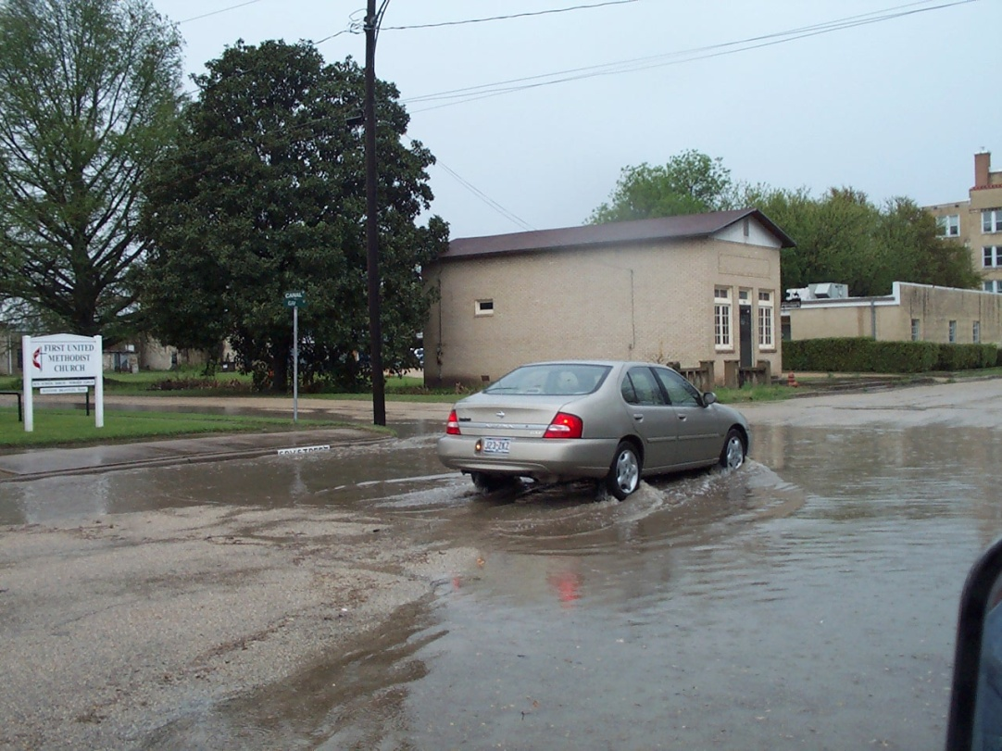
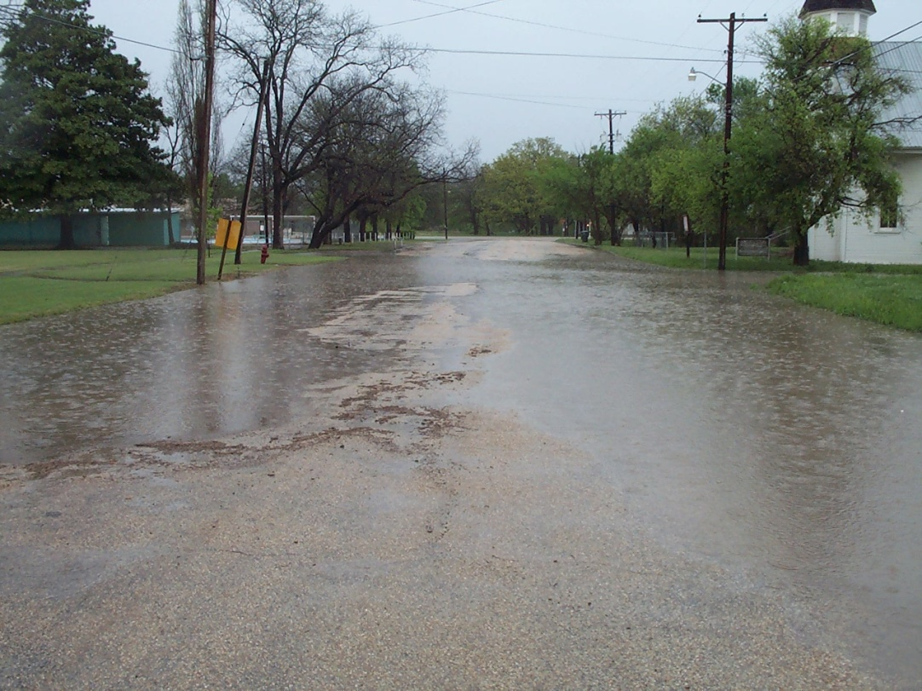
Increased Impervious Area
from pavement & roofs
Notes:
Storm water runoff is a real problem for may communities. It is sometimes a problem for households. The hard surfaces in cities and around homes has increased. By preventing the runoff from roofs, parks, etc. we can reduce the storm water runoff problem.

Slide 6
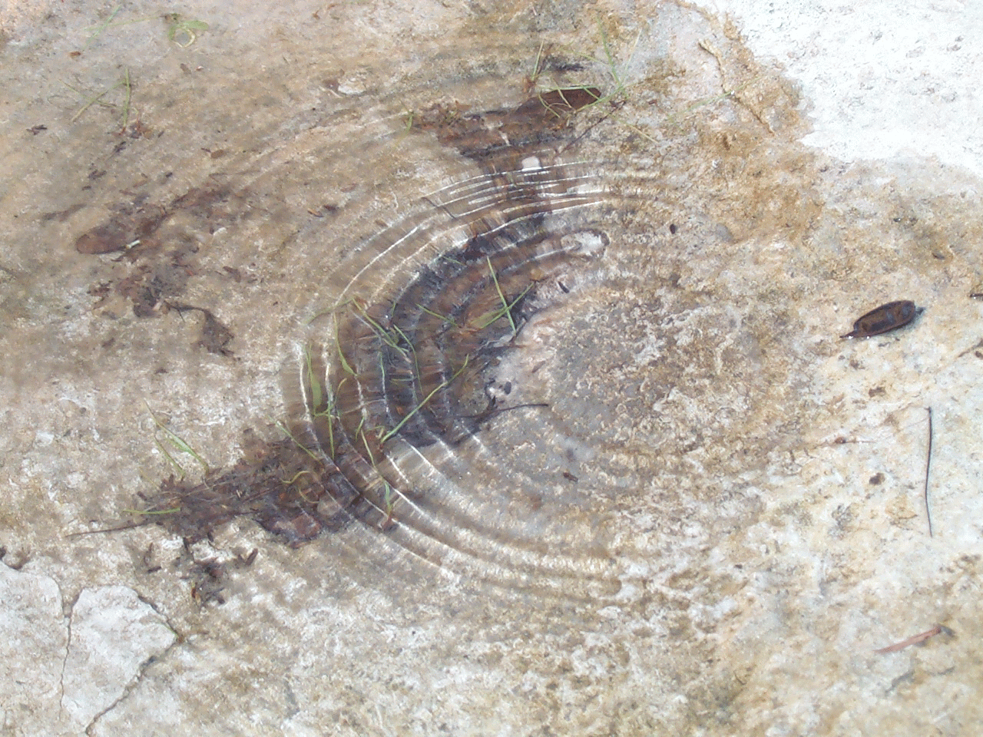
Value of Rainwater
Low pH 6.0 to 7.0
High quality water
Free
Makes You Conservation Minded
Notes:
Read slide

Slide 7
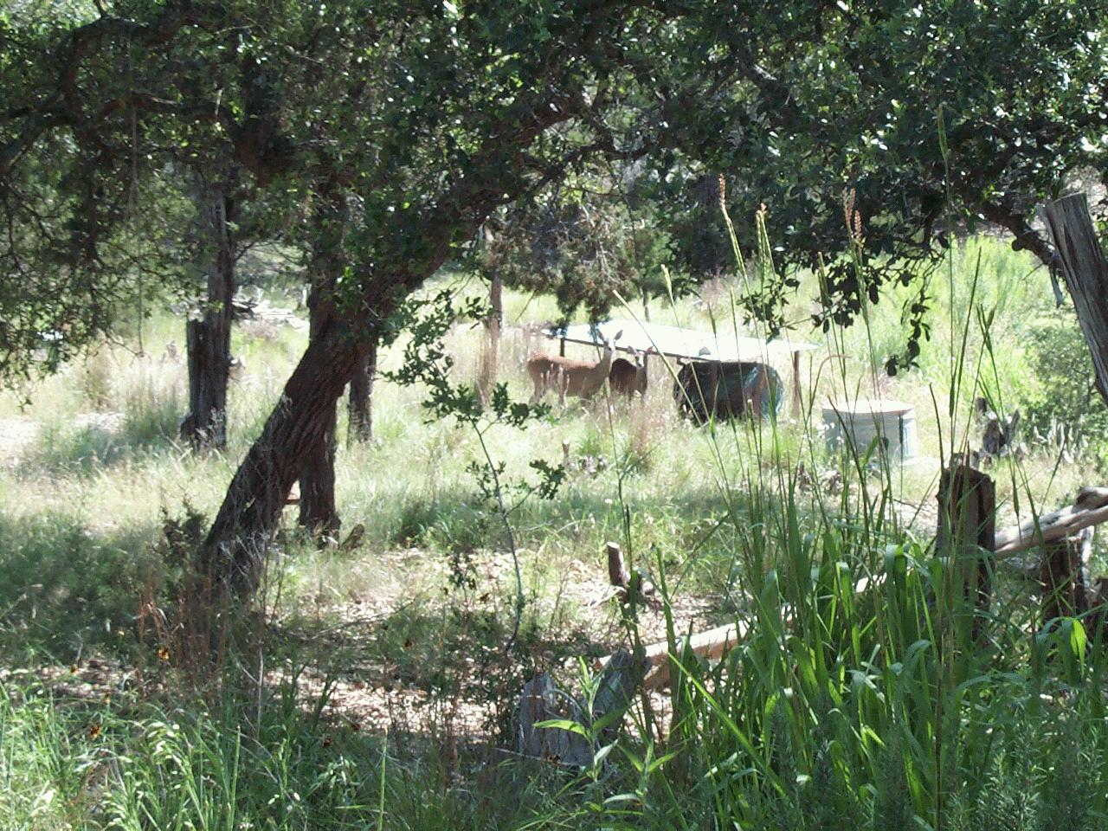
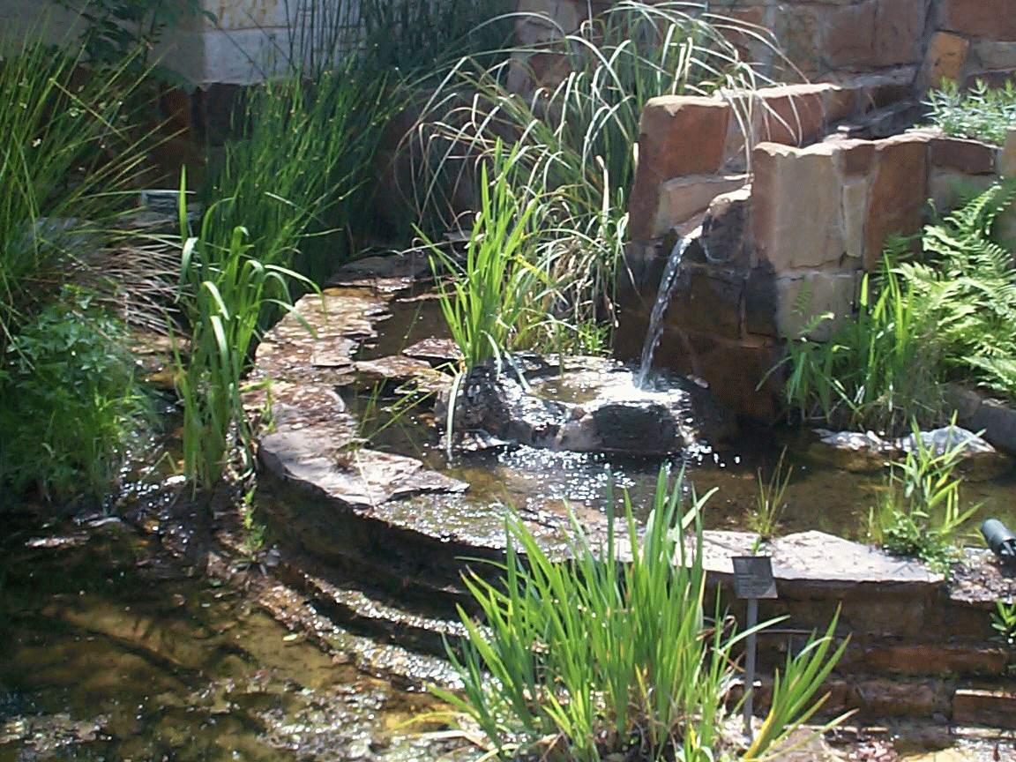
Rainwater Uses
Attract and provide water for wildlife, pets, birds and butterflies
Landscape irrigation, house plants
In home use – laundry, bath/shower, drinking, cleaning, etc.
Notes:
Rainwater can be used for anything that municipal or well water can be used for. It typically has fewer minerals in it which makes it good for your plants. If you use it for drinking water in the home, it should be treated.

Slide 8
How to Catch Rainwater
* Roof – Sloped Tin is best but any will work
* .6 gallons per square foot roof
* 2,000 sq. foot roof X 1" rain = 1,200 gal. water
* 1,200 gal. X 20" rainfall per year= 24,000 gal/yr.
* 12” rain yields 14,400 gals./yr.
* 6” rain yields 7,200 gals./yr.
Notes:
Homeowners can collect, store and use about 600 gallons per 1000 square feet of roof and pavement areas for each inch of rainfall. Do the calculations based on your annual rainfall. Lubbock has average rainfall of 18” per year. 18 X 1,200 gal. = 21,600 gallons captured. With water saving landscape plants and efficient irrigation, this should be enough water along with the falling rain for the landscape. Remember that landscapes are not watered year round.

Slide 9
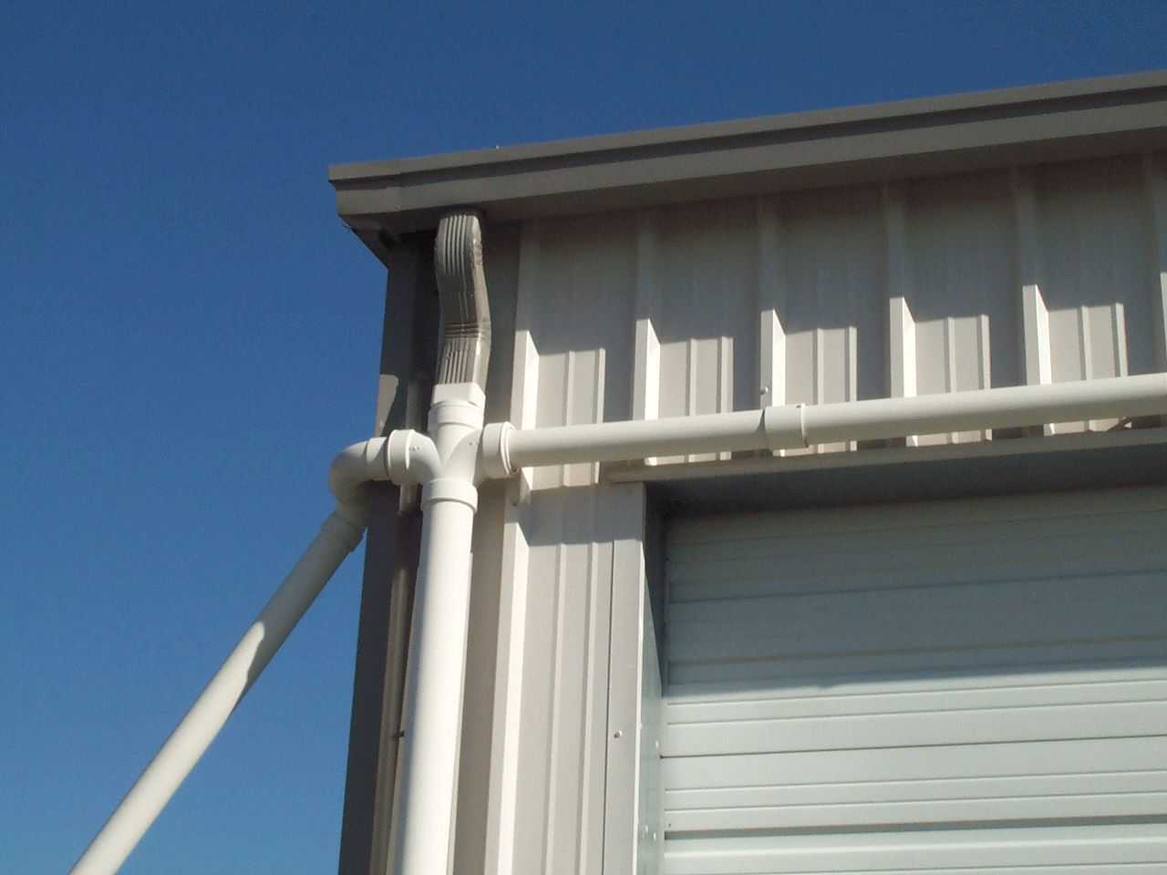
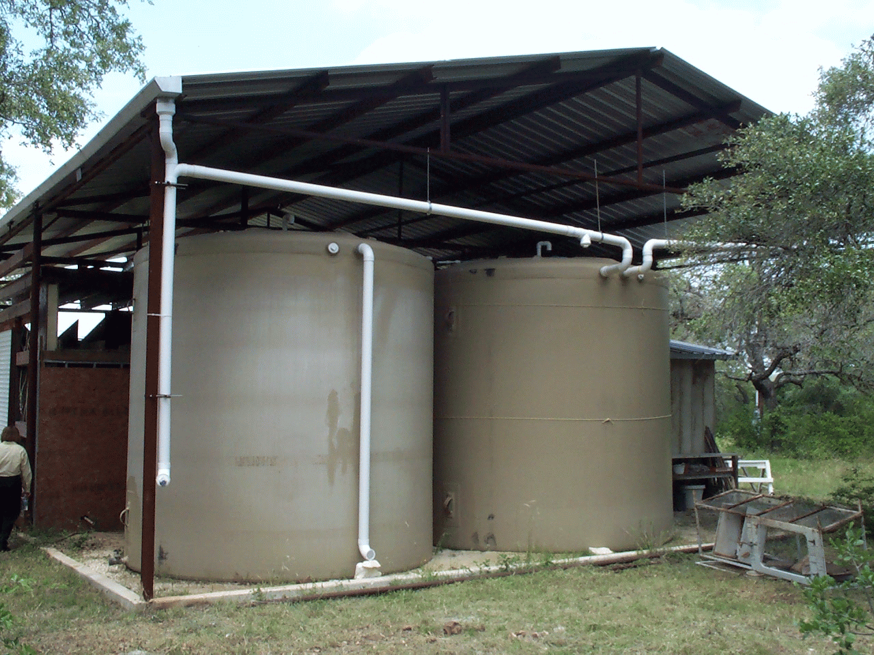
Gutters and Roof Washers
Gutters - Nothing special
Roof washers - removes trash, debris & dust

Slide 10
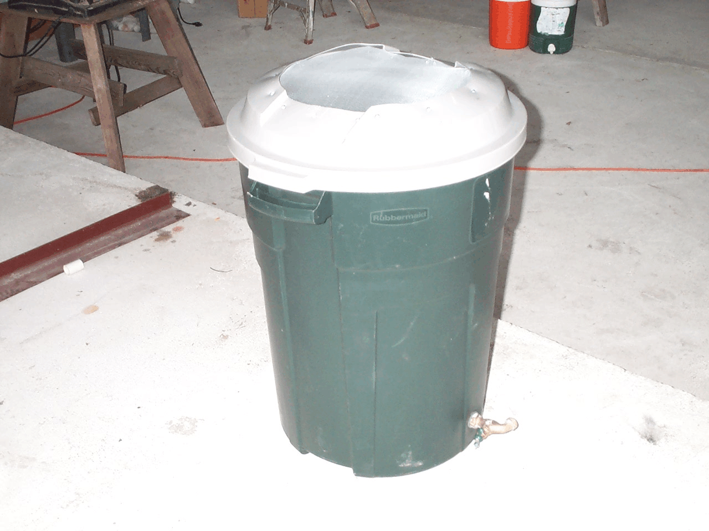
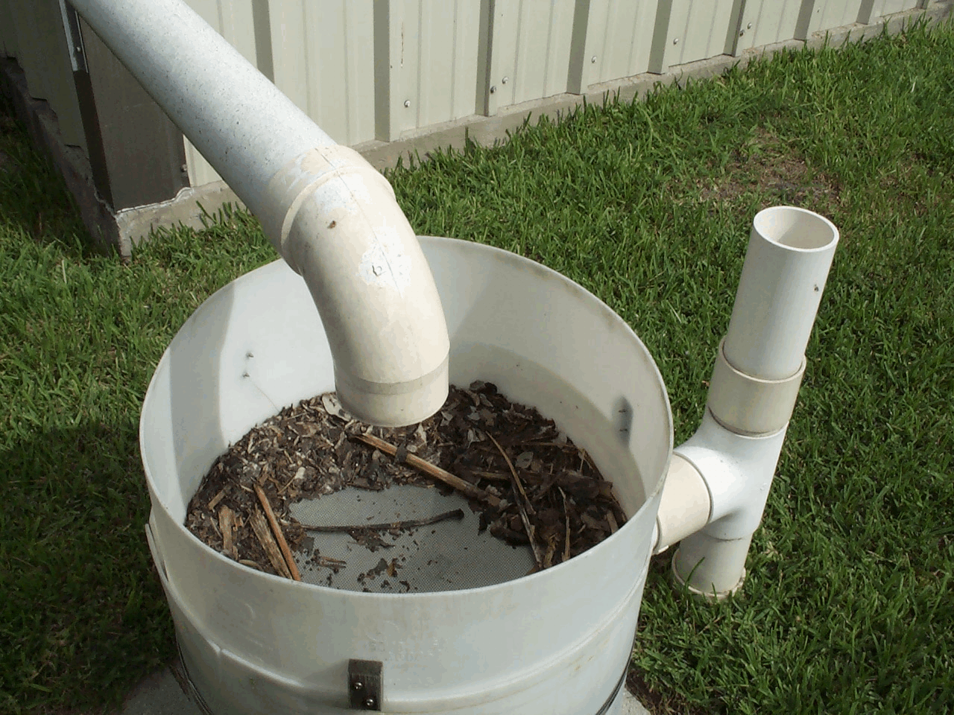
Screens to Keep Out Trash & Mosquitoes

Slide 11
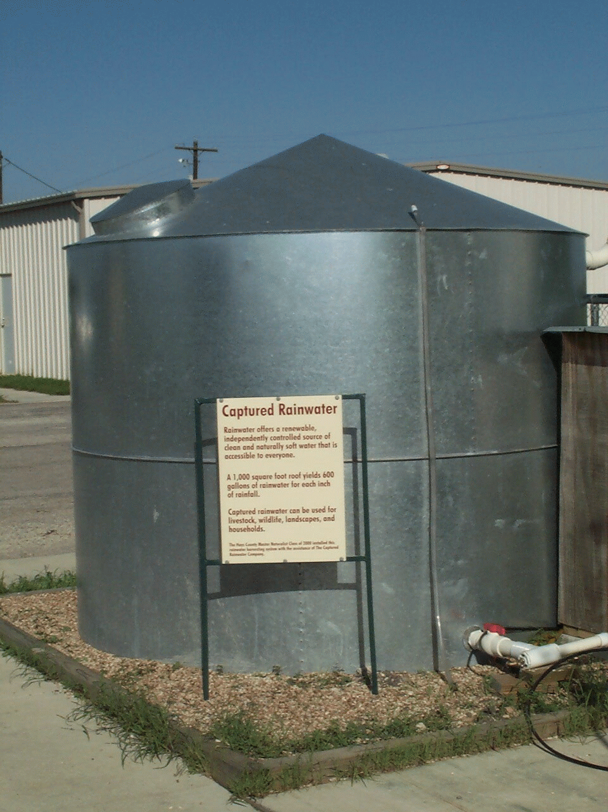
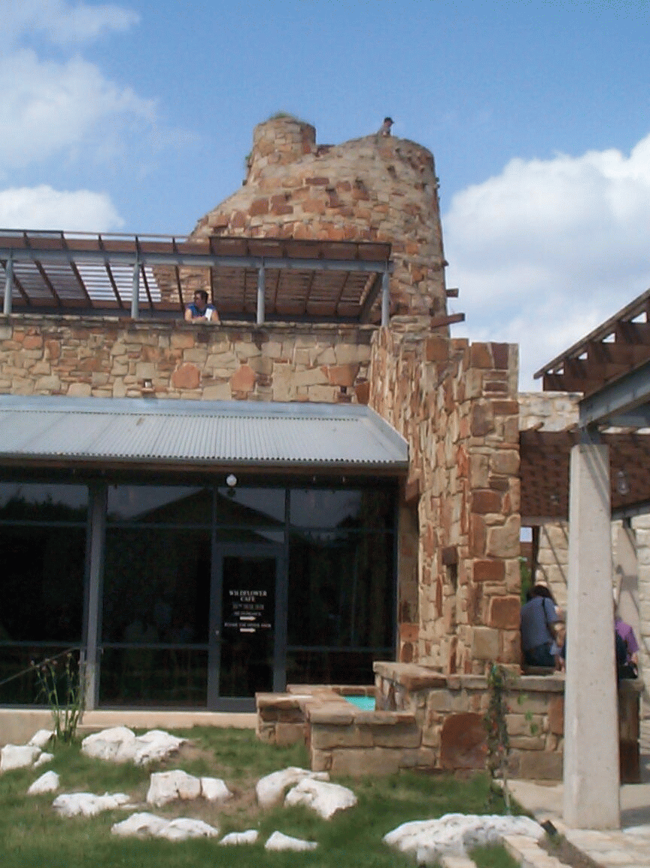
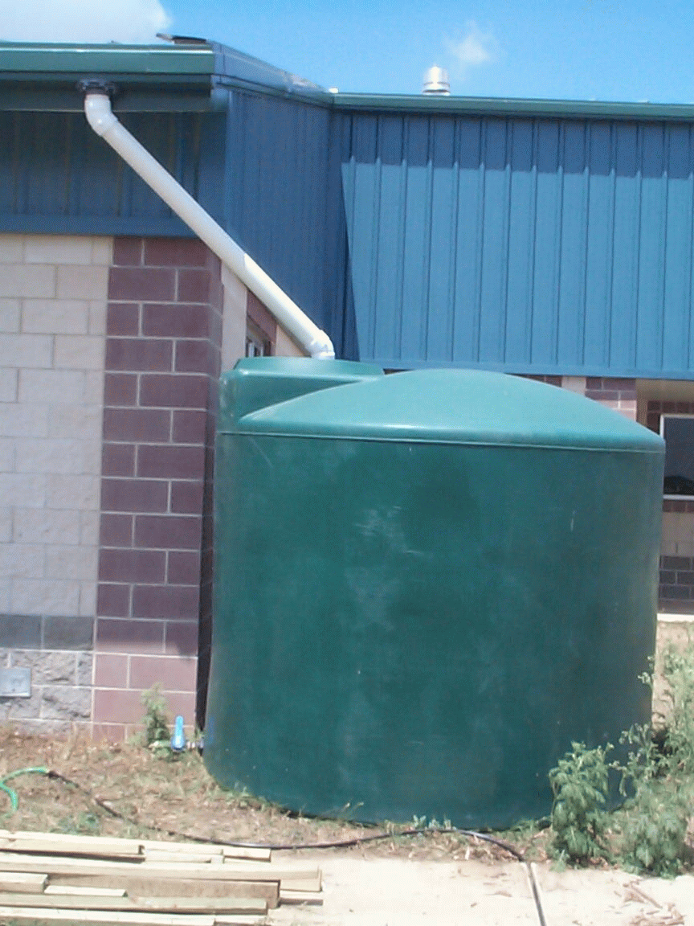
Cisterns or Tanks for Storage of Water
Durable and water tight – material
Opaque
Size – depends on how much you will collect and need and where the water will be used
Cost - $ .30 - 1.25 per gallon collected

Slide 12

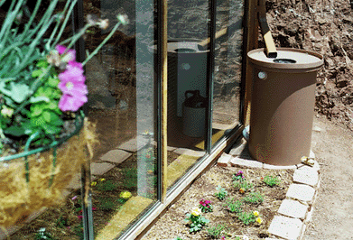
Small Rain Barrels

Slide 13
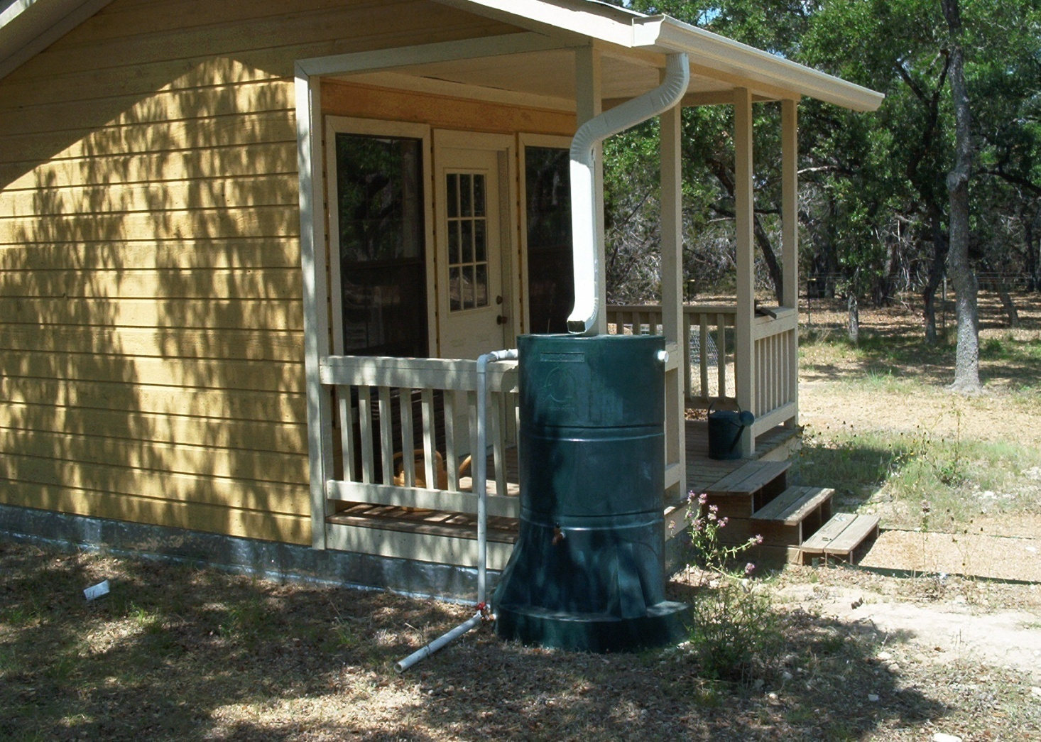
Simple Rain Barrel w/Gutter

Slide 14
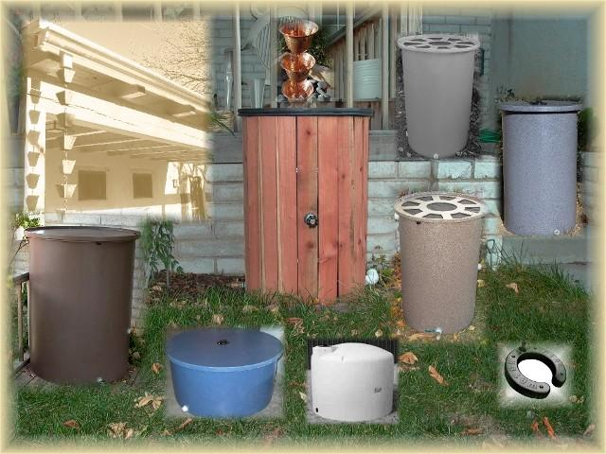
Selection – Size, Color, Shape

Slide 15
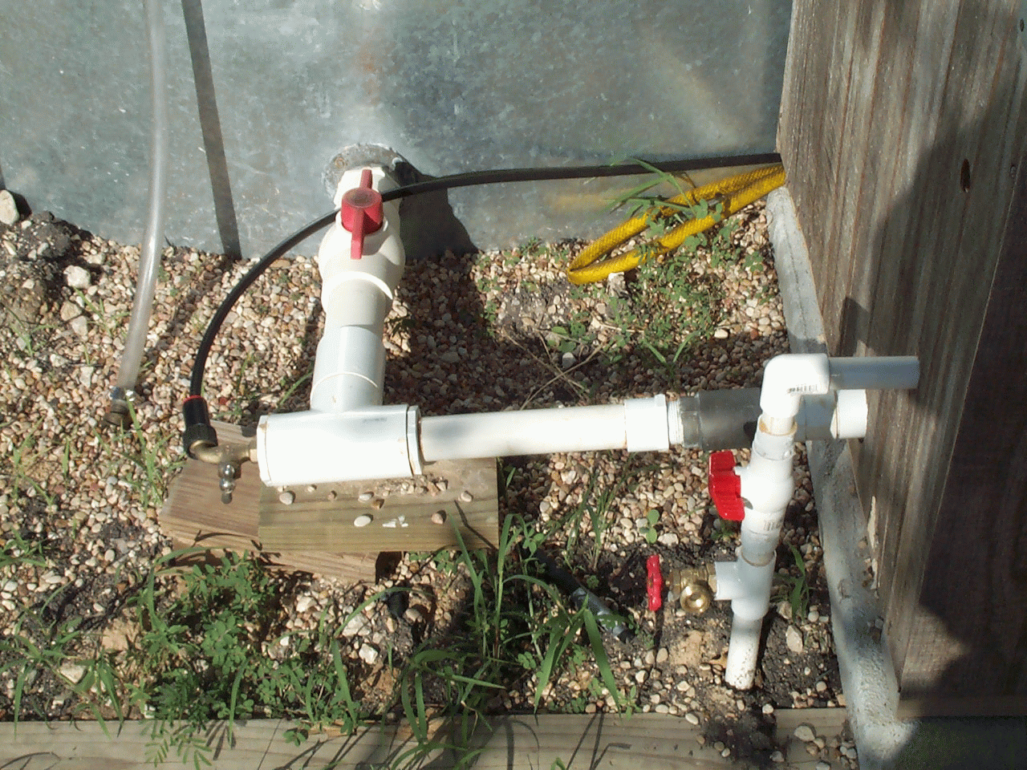
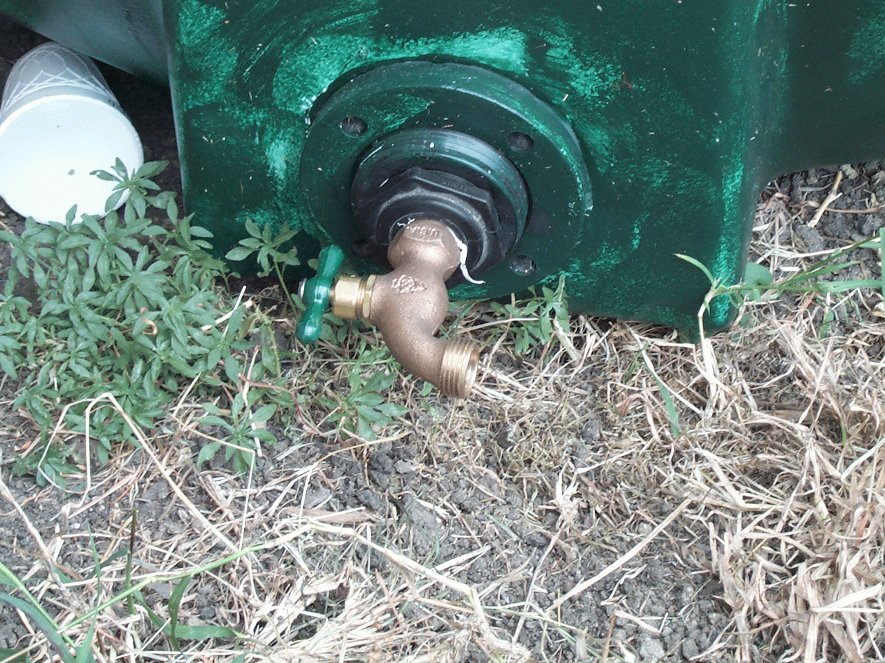
The Other Parts
Gate valve and facets

Slide 16
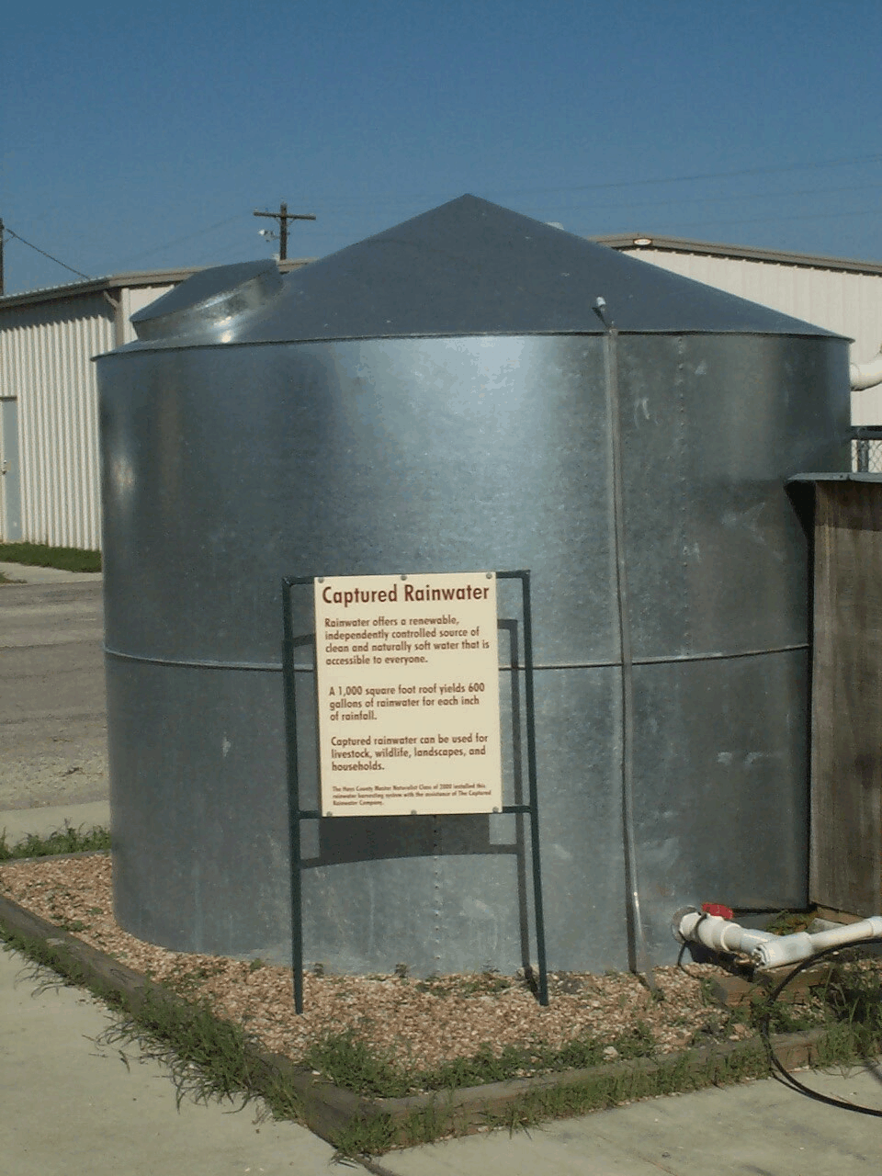
Water Gauge
The clear plastic hose allows water to rise to the level the water is inside the tank

Slide 17
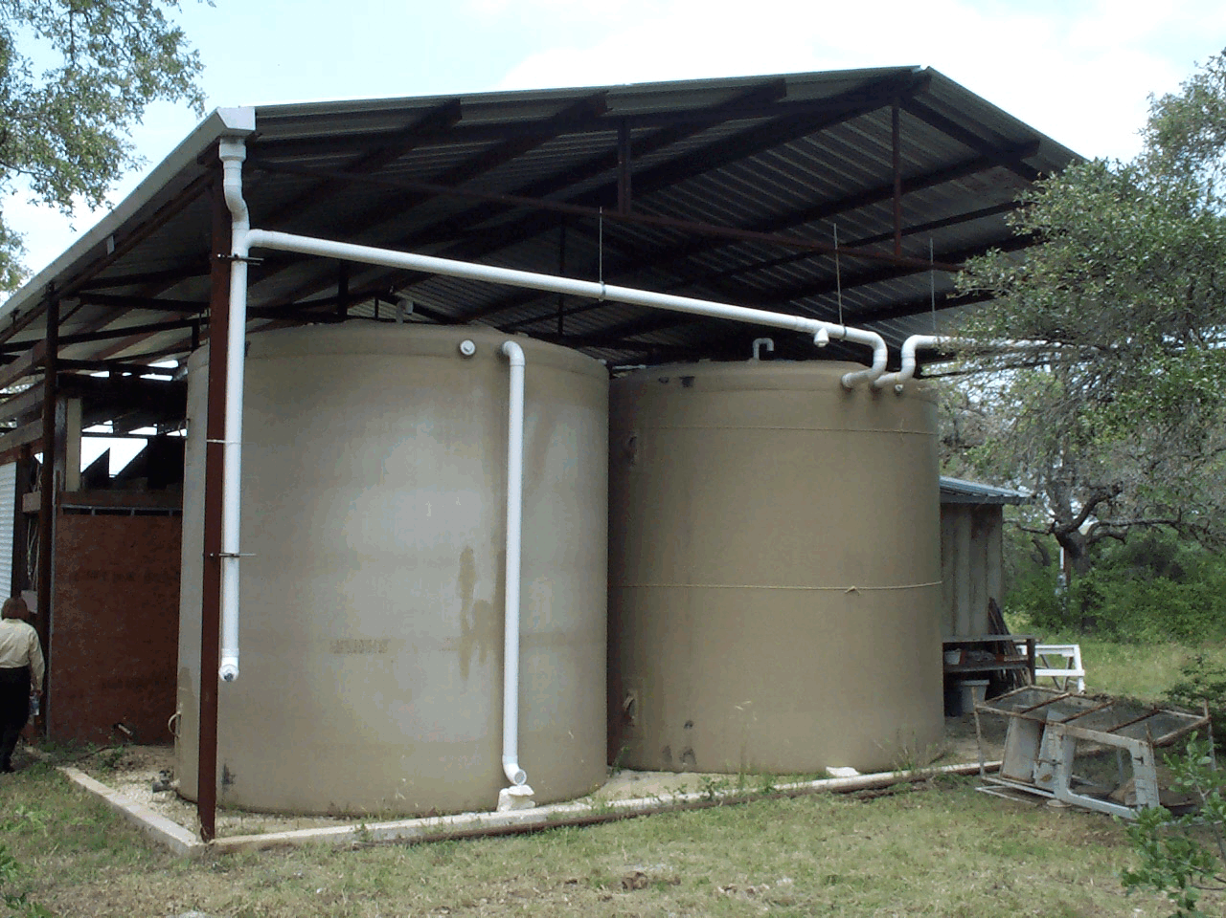
Overflow Pipe
Overflow allows water to run out of tank when full rather than backing up into the gutter of this
Rain Barn
Notes:
One other feature that is illustrated on this picture is the first flush standpipe (with a valve and bottom cleanout). As the water rushes off the roof, it goes into the vertical stand pipe. When the vertical pipe is filled, the water than goes into the horizontal pipe and begins filling the storage tank. After the rain stops, the standpipe is drained in preparation for the next rain.

Slide 18
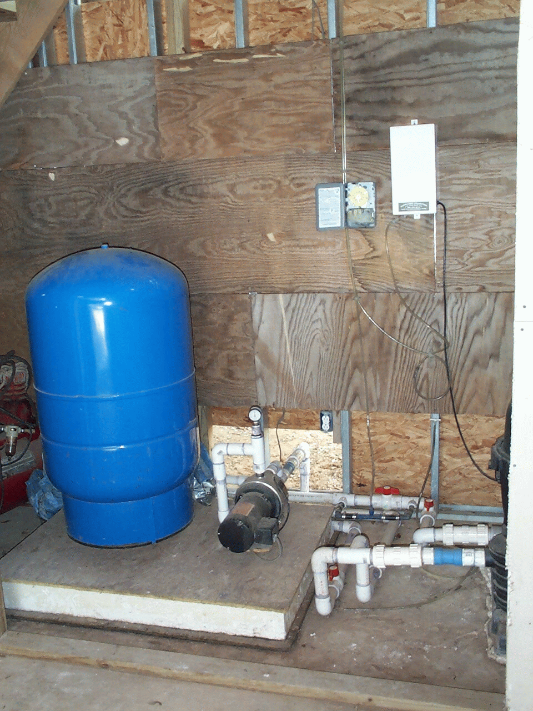
Pump and Pressure Tank
Notes:
If a system if not gravity-fed, an electric pump may be needed. If you are using the harvested water for household use, a pressure tank likely will be needed. This would assist with the distribution of the water.

Slide 19
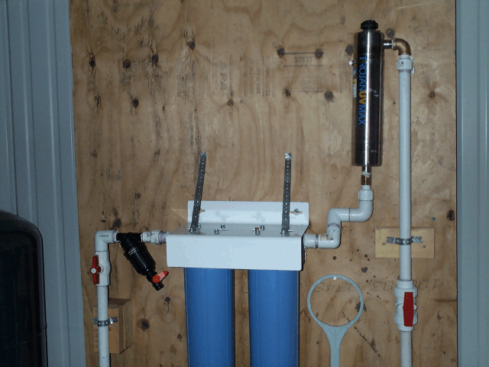
Filters and Sanitizers – Drinking H2O
Notes:
Filters and sanitizers are necessary if the water is to be used as the source of drinking water. Roofwashing, filters, and continuous disinfection help to assure safe water for human consumption.. Most common methods used to disinfect the water are ultraviolet light or chemical disinfection.

Slide 20
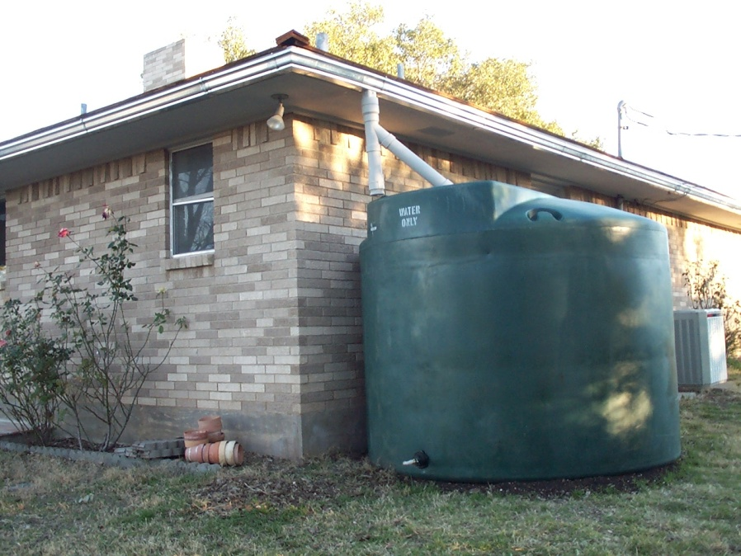
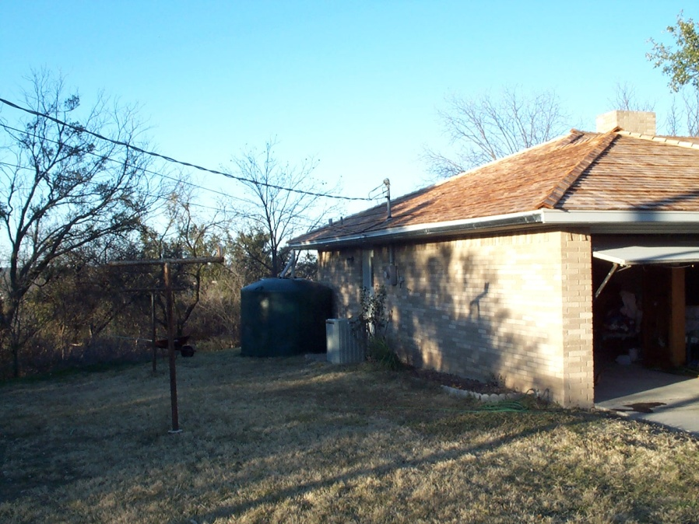
Distribute Water to Desired Location
Drip irrigation – Landscape or Garden
Water garden in ground
Wildlife and pet water
Sprinklers, misters & watering with pressure
In home uses

Slide 21
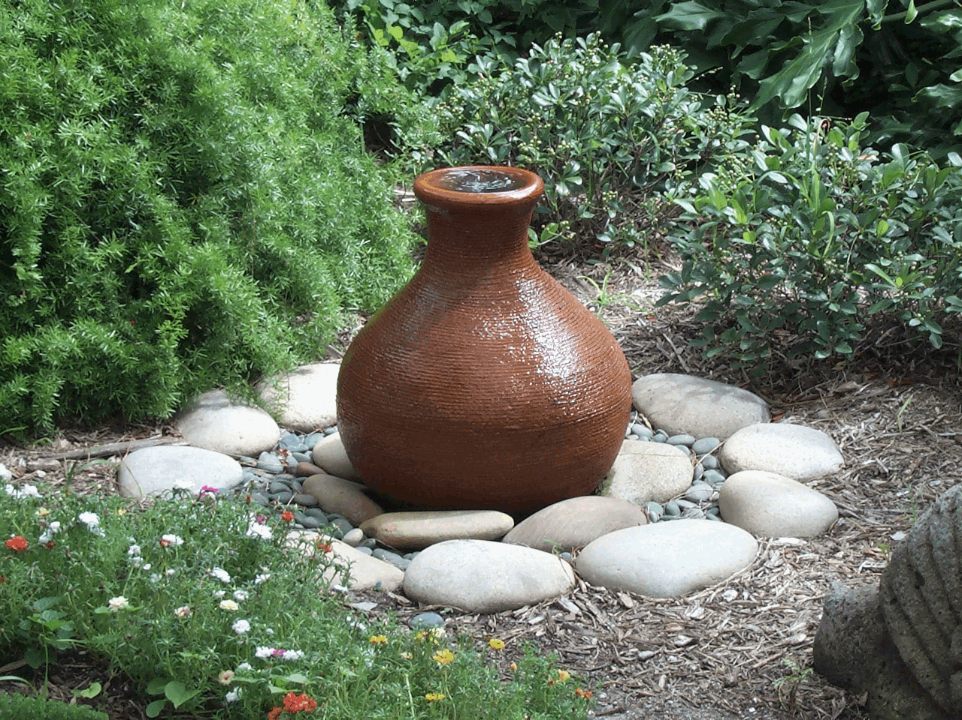
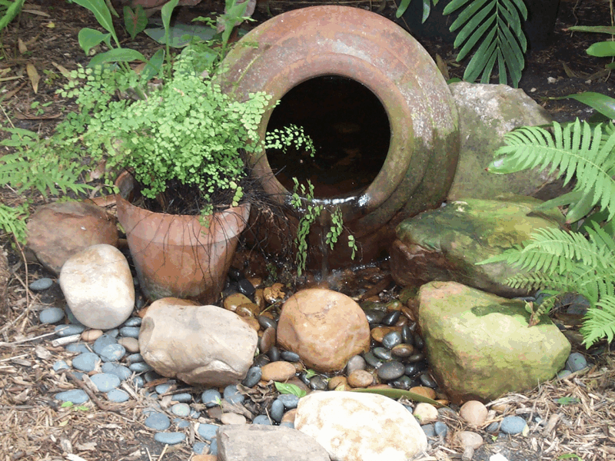
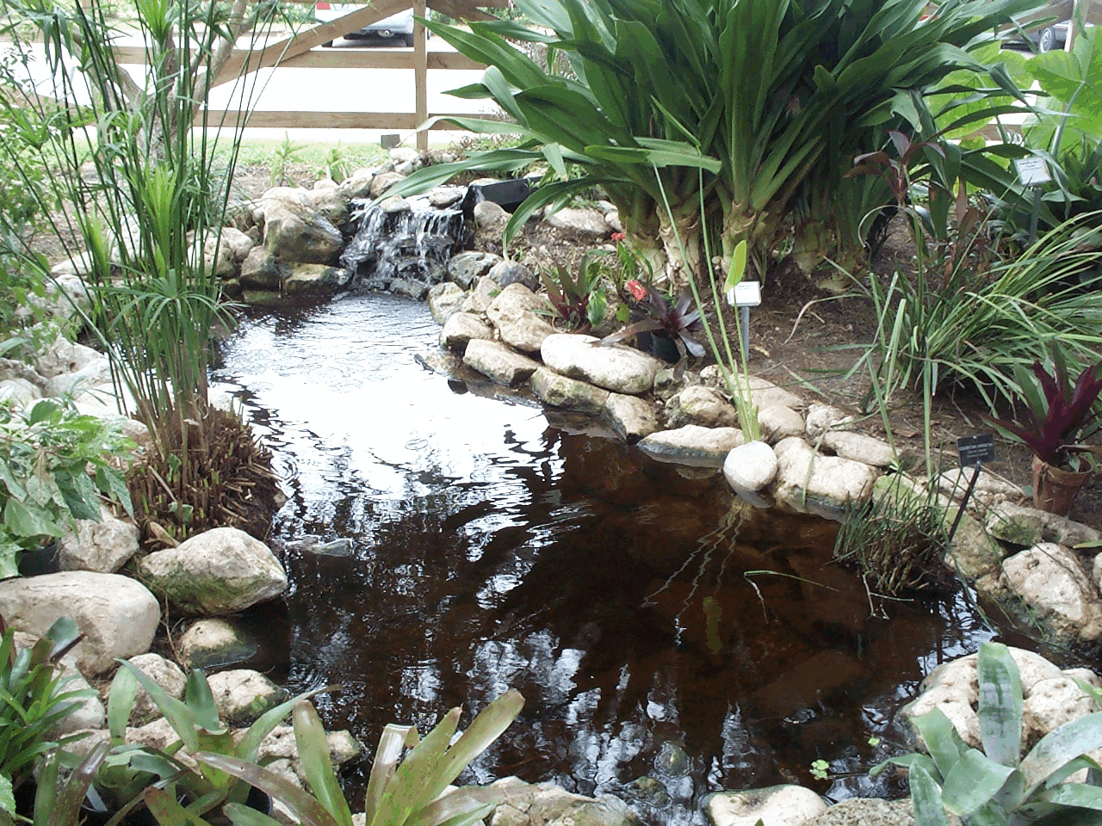
Water Features in Landscape
Rainwater can be used in a water feature with floats that keep the water level high enough to run reciprocating pumps.

Slide 22
Rainwater Harvesting
Rainwater harvesting captures, diverts and stores rainwater for later use.
Easiest use is for landscaping irrigation
Can be used for household use with proper treatment.
Rainwater is good for plants because it is free of salts and other minerals

Slide 23
Rainwater Harvesting
Reduces the demand for chlorinated or other chemically treated tap water therefore you buy less water
Reduces the amount of water that will go into storm sewers where it is mixed with oil and other toxic residues from streets, parking lots etc.

Slide 24
Resources
Rainwater Harvesting – B-6153 Texas AgriLife Extension Service, TAMUS
http://agrilifebookstore.org/publications_details.cfm?
whichpublication=1979 $4.50
Texas Guide to Rainwater Harvesting, Texas Water Development Board
http://www.twdb.state.tx.us/assistance/conservation/Alternative_Technologies/Rainwater_Harvesting/Rain.asp

Slide 25
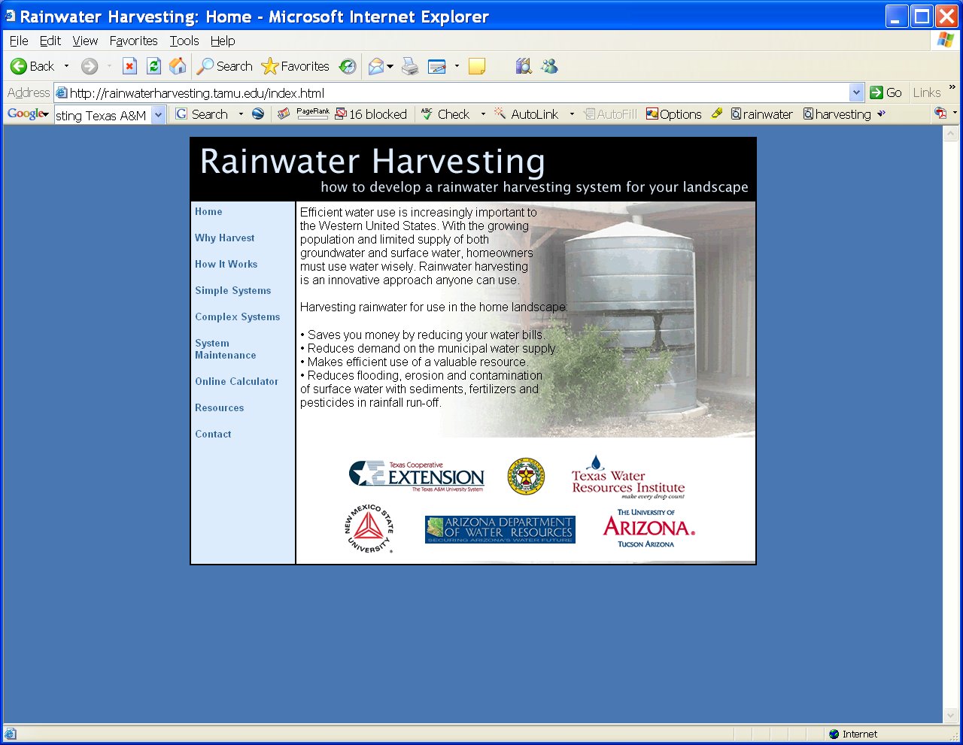


Slide 26
Special Thanks to:
Billy Kniffen
CEA-AG
Menard, Texas 76859
325-393-2120
e-mail:
b-kniffen@tamu.edu

